Slide 1

ECE 281 Lesson 21
Maj Jeffrey Falkinburg USAFA/DFEC
Room 2E46E 333-9193
1

Slide 2
Lesson 21 Outline
Do Time Logs!
Lab2 Notebook Due @ COB Today, but no Penalty if turned in by 2359 Sunday!
Quiz Next Time?
Sequential Building Blocks
Counters
Shift Registers
Memory
RAM
ROM

Slide 3
Sequential Building Blocks
What is the Difference between Sequential and Combinational Logic Circuits?
Sequential has memory (i.e. Flip-Flops)

Slide 4
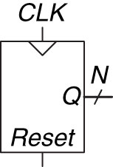
Counter Symbol
Figure 5.30 Counter symbol
Copyright © 2013 Elsevier Inc. All rights reserved.

Slide 5
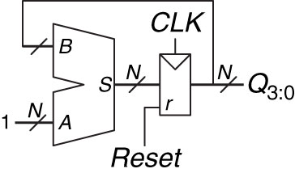
N-Bit Counter
Figure 5.31 N-bit counter
Copyright © 2013 Elsevier Inc. All rights reserved.

Slide 6
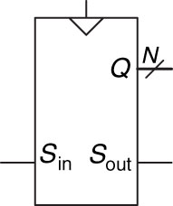
Shift Register Symbol
Figure 5.33 Shift register symbol
Copyright © 2013 Elsevier Inc. All rights reserved.

Slide 7
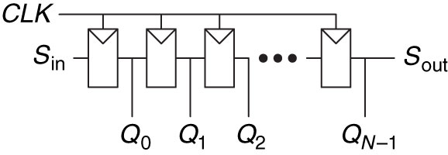
Shift Register Schematic
Figure 5.34 Shift register schematic
Copyright © 2013 Elsevier Inc. All rights reserved.

Slide 8
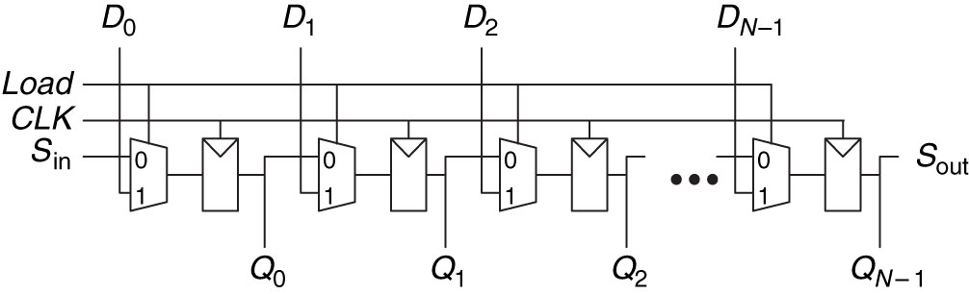
Shift Register with Parallel Load
What is the difference between a Shifter and a Shift Register?
A shifter is purely combinational logic
Figure 5.35 Shift register with parallel load
Copyright © 2013 Elsevier Inc. All rights reserved.

Slide 9
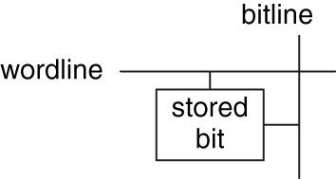
Memory
Address – Indicates which row of memory is read/written (location) 2^{N} (N-Bits)
Data – Value read/written M-Bits
Word – size of a row of data (M-Bits)
Depth – Number of rows
Width – Number of Columns
Wordline – Assert based on address to activate bit cells in a row
Bitline – kept at Z; when wordline is activated, driven to 1 or 0 by bit cell to read
When written , drives bit cell high or low
Port – Gives read/write access to the address; multi-ported can read/write several addresses at the same time

Slide 10
Bit Cell
Figure 5.41 Bit cell
Copyright © 2013 Elsevier Inc. All rights reserved.

Slide 11
Memory
Registers of Flip-Flops can store small amounts of data
Memory arrays can store large amounts of data
Memory reads/writes contents of one row of the array

Slide 12
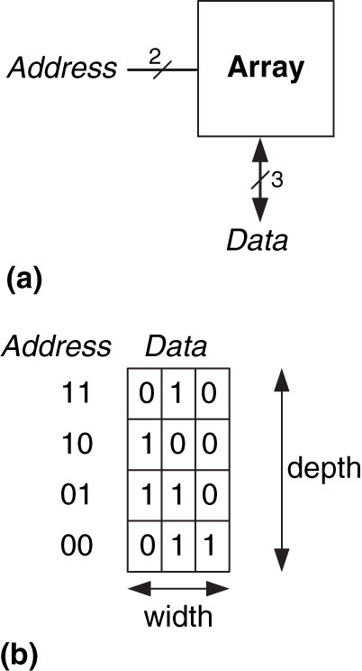
3-Bit Memory Array
Figure 5.39 4  3 memory array: (a) symbol, (b) function
Copyright © 2013 Elsevier Inc. All rights reserved.

Slide 13
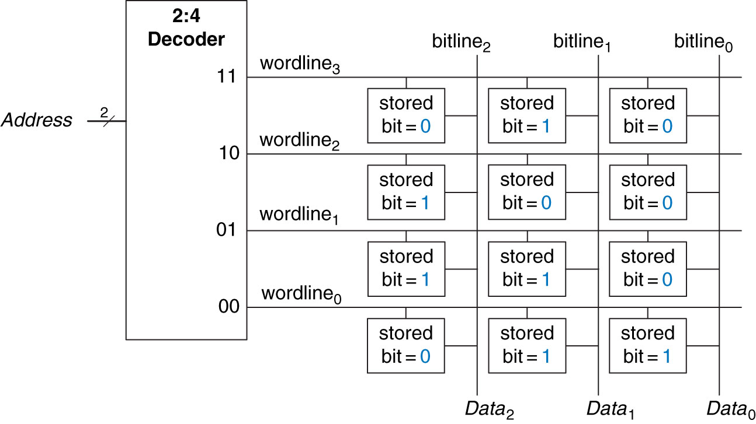
4x3 Memory Array
Figure 5.42 4  3 memory array
Copyright © 2013 Elsevier Inc. All rights reserved.

Slide 14
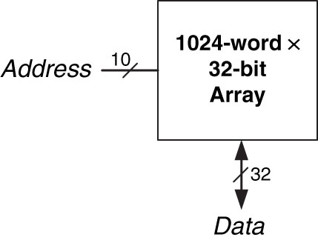
32 Kb Array
Figure 5.40 32 Kb array: depth = 2¹⁰ = 1024 words, width = 32 bits
Copyright © 2013 Elsevier Inc. All rights reserved.

Slide 15
Types of Memory
Types of memory:
RAM –
Random Access Memory
Delay same for all addresses, vs sequential (e.g. type)
Volatile – Loses its data when the power is lost
ROM –
Read Only Memory
Also randomly accessed
Many can be written now
Non-Volatile

Slide 16
Types of RAM
DRAM – Dynamic RAM
Bit stored as absence or presence of charge on a capacitor
Reading destroys data; must be rewritten
Must be refreshed every few miliseconds due to leaking charge

Slide 17
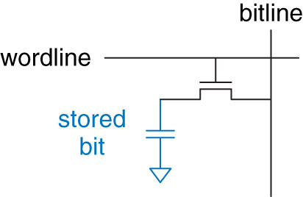
DRAM Bit Cell
Figure 5.44 DRAM bit cell
Copyright © 2013 Elsevier Inc. All rights reserved.

Slide 18
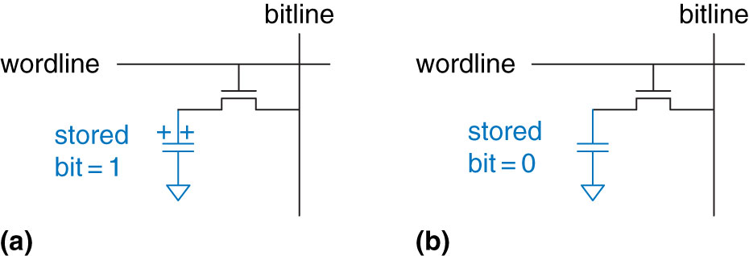
DRAM Stored Values
Figure 5.45 DRAM stored values
Copyright © 2013 Elsevier Inc. All rights reserved.

Slide 19
Types of DRAM
DRAM – Dynamic RAM
Bit stored as absence or presence of charge on a capacitor
Reading destroys data; must be rewritten
Must be refreshed every few miliseconds due to leaking charge
SDRAM – Synchronous DRAM
Uses pipelined memory access
DDR SDRAM – Double data rate SDRAM
Uses Rising and falling edge to access data

Slide 20
Types of RAM
SRAM – Static RAM
Does not need refreshing
Bit stored in cross coupled inverters
Inverters can restore value if noise interferes

Slide 21
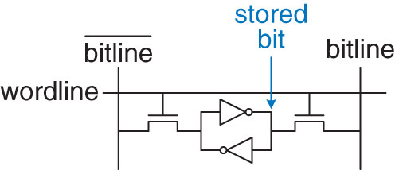
SRAM Bit Cell
Figure 5.46 SRAM bit cell
Copyright © 2013 Elsevier Inc. All rights reserved.

Slide 22
Types of RAM
Larger memories tend to be slower
More transistors = more size, power, and cost
Best Memory depends on speed, cost, power constraints
Memory Type | Transistors per bit cell | Latency
Flip-Flop
SRAM
DRAM
Memory Type | Transistors per bit cell | Latency
Flip-Flop | ~20 | Fast
SRAM | 6 | Medium
DRAM | 1 | Slow

Slide 23
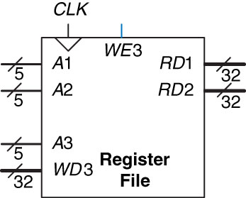
Register File
Register File – Group of registers that stores temporary variables
Often consists of small multiported SRAM
Figure 5.47 32  32 register file with two read ports and one write port
Copyright © 2013 Elsevier Inc. All rights reserved.

Slide 24
Types of ROM
PROM – Programmable Read Only Memory – Provides a way to connect transistor with ground
Fuse Programmable ROM – blow fuse = 1, cannot be rewritten
EPROM – Eraseable PROM
High voltage to write
UV light to erase
EEPROM – Electrically EPROM
Bit cells individually erased
Erased without UV light with extra circuitry
Flash – Large blocks erased
Cheaper because less erasing circuitry

Slide 25
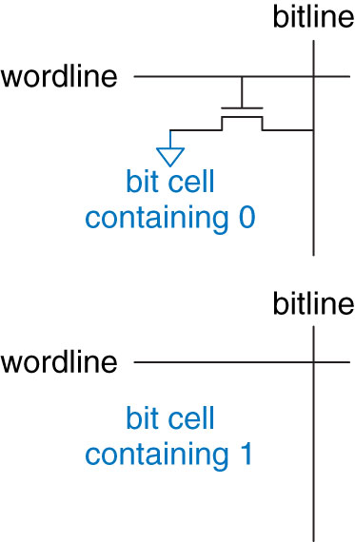
ROM Bit Cells
Programmable ROM – Provides a way to connect transistor with ground
Figure 5.48 ROM bit cells containing 0 and 1
Copyright © 2013 Elsevier Inc. All rights reserved.

Slide 26
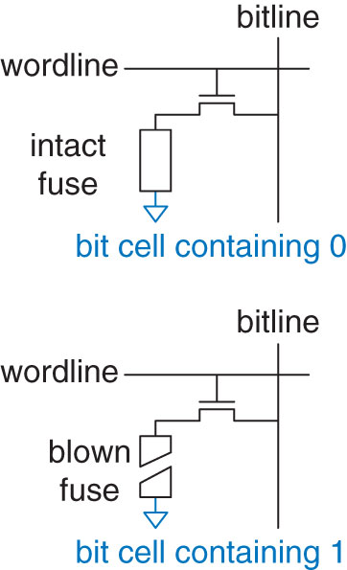
Fuse-Programmable ROM Bit Cell
Figure 5.51 Fuse-programmable ROM bit cell
Copyright © 2013 Elsevier Inc. All rights reserved.

Slide 27
Types of ROM
PROM – Programmable Read Only Memory – Provides a way to connect transistor with ground
Fuse Programmable ROM – blow fuse = 1, cannot be rewritten
EPROM – Eraseable PROM
High voltage to write
UV light to erase
EEPROM – Electrically EPROM
Bit cells individually erased
Erased without UV light with extra circuitry
Flash – Large blocks erased
Cheaper because less erasing circuitry

Slide 28
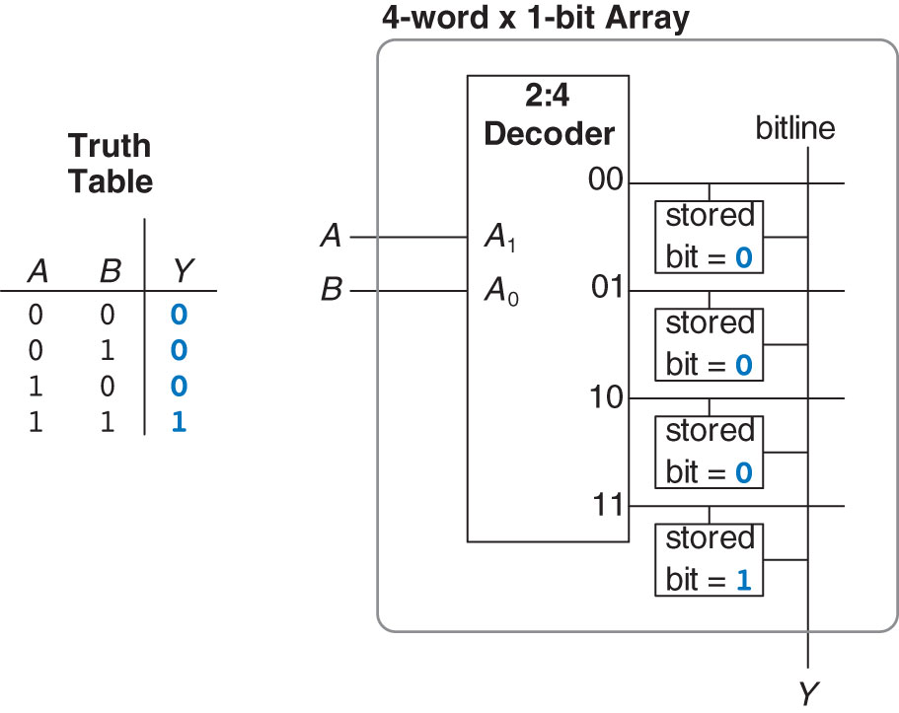
4-Word – 1-Bit memory array used as lookup table
Figure 5.52 4-word  1-bit memory array used as a lookup table
Copyright © 2013 Elsevier Inc. All rights reserved.

Slide 29
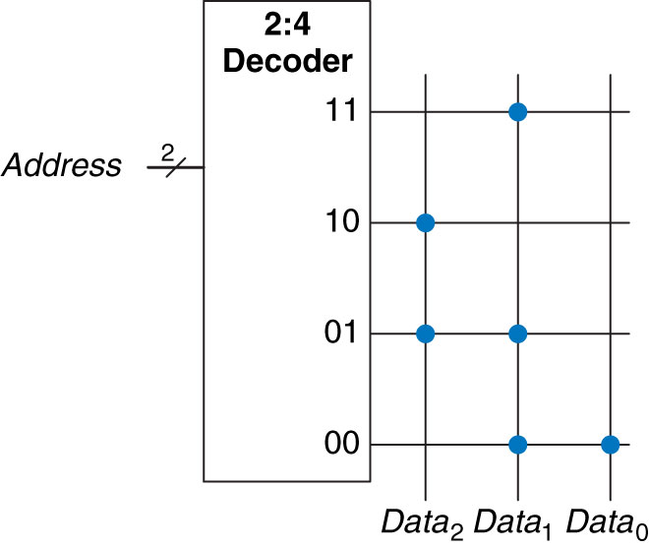
3 ROM Dot Notation
Figure 5.49 4  3 ROM: dot notation
Copyright © 2013 Elsevier Inc. All rights reserved.

Slide 30
3 ROM Dot Notation
Figure 5.49 4  3 ROM: dot notation
Copyright © 2013 Elsevier Inc. All rights reserved.

Slide 31
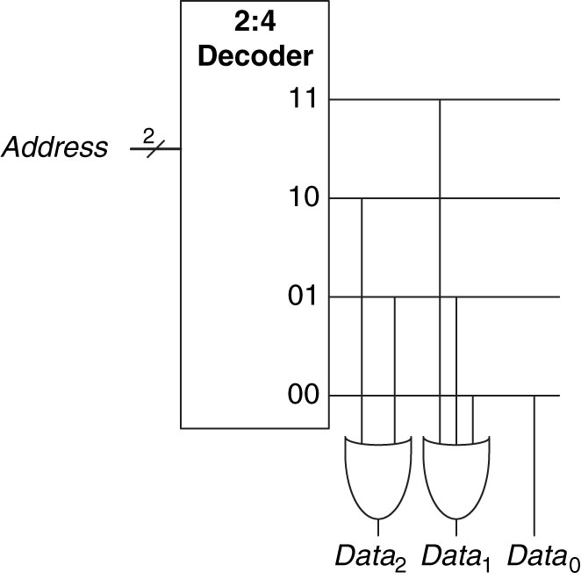
3 ROM Dot Notation – using gates
Figure 5.50 4  3 ROM implementation using gates
Copyright © 2013 Elsevier Inc. All rights reserved.

Slide 32
Practice
5.43: Build a 32-Bit Synchronous Up/Down Counter
Inputs: Reset, Up = 1 (i.e. Up)

Slide 33
Extra Instruction (EI)
Maj Jeffrey Falkinburg
2E46E
Office: 333-9193
M1
ECE 281 – 2F44
T1
M2
ECE 281 – 2F44
T2
M3
ECE 463 – 2G2
T3
ECE 383 – 2E48A
M4
ECE 463 – 2G2
T4
ECE 383 – 2E48A
Available
M5
T5
Sometimes Available
M6
ECE 383 – 2E48A
T6
Always Unavailable
M7
ECE 383 – 2E48A
T7

Slide 34

34

